Slide 1
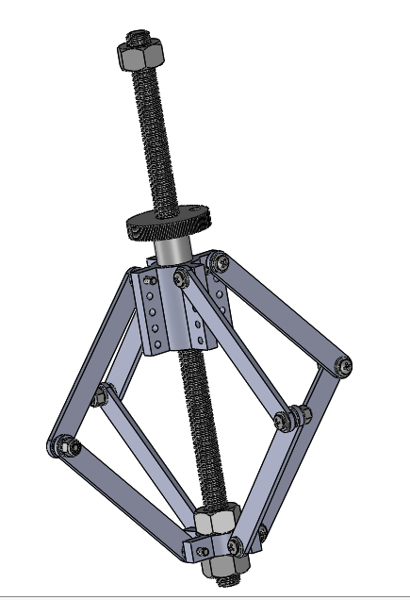
Fundamentals of Precision Product Design FPGA 3
Serena Le
Tahina Felisca
2.70
4/1/2019
Expanding Lead Screw Assembly
The expansion mechanism is designed to mimic Abbe error in a nut thread using the principles of precision, repeatability, and critical dimensions. The vertical and horizontal difference between pivot joints at different effective screw thread angles were measured.

Slide 2
FRDPARRC
Functional Reqs | Design Parameters | Analysis | References | Risks | CMs
Abbe Error | Linkage Pivot Point | Position of Linkages as pivot point changes | Hoberman Spheres | Slop in Joints | Locknuts & Hex nuts
Precision | Leadscrew and nut | Center of rotation | Four Bar Linkages | Keyhole applies too much friction on carriage | Keyhole slot
Repeatability |  |  | St Venant's

Slide 3
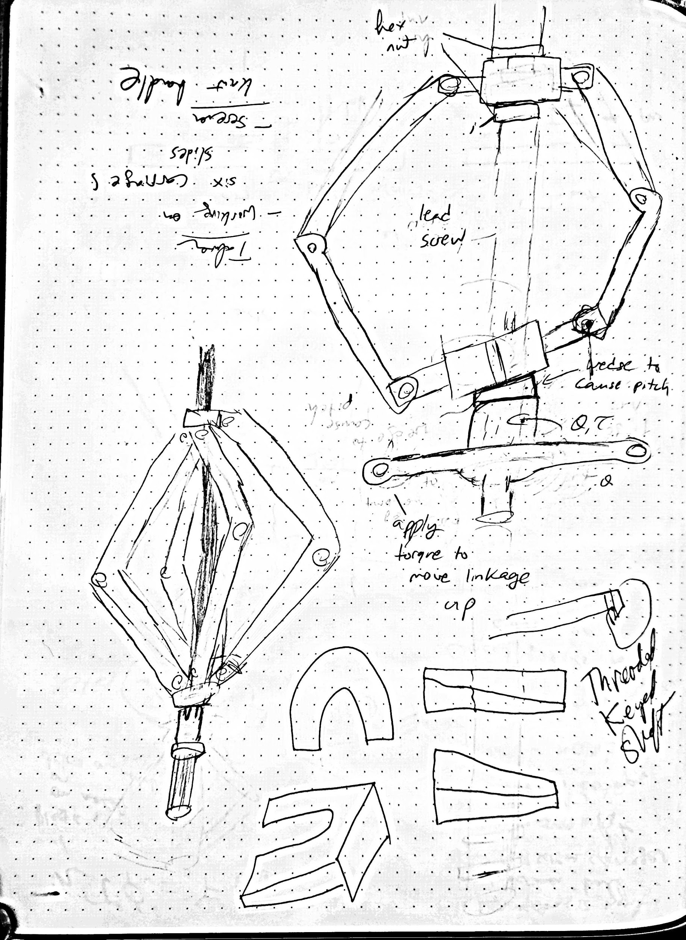
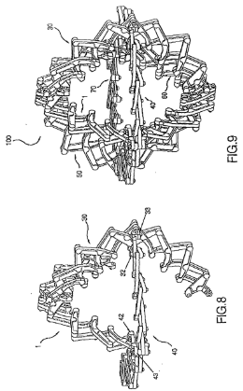
Strategies and Concepts
Inspired by Hoberman Spheres
Initial Idea: Modify pitch of carriage using a wedge in the assembly

Slide 4
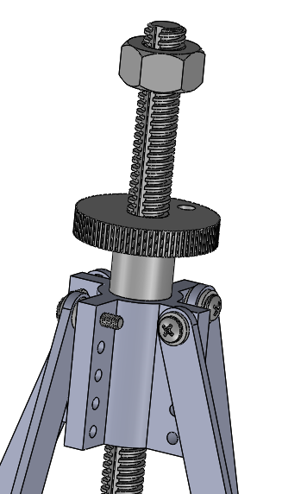
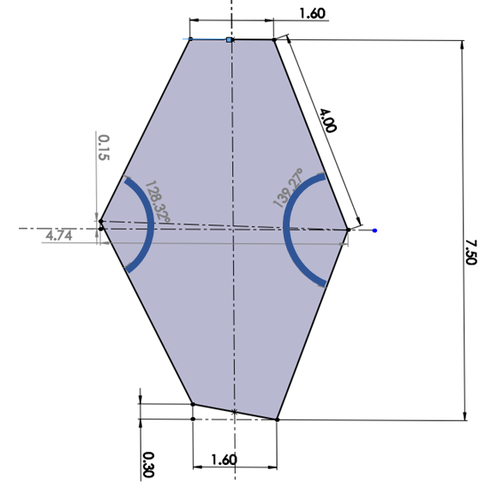
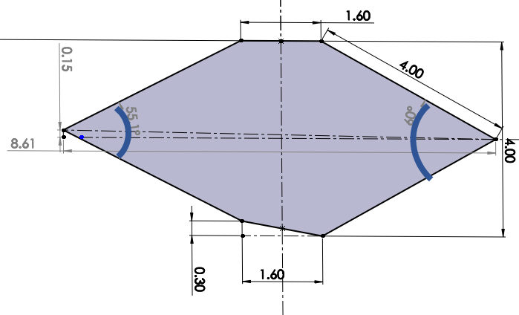
Design Principles
Prevent yaw in Z axis with the keyhole slot
Use hex nuts as hard stops for the assembly
Apply St Venant’s in the design of the carriage -Holes are located 4 characteristic dimensions from critical features -length of the carriage 4x that of the diameter of the lead screw
Holes for bolts are waterjeted with a quality of 4

Slide 5
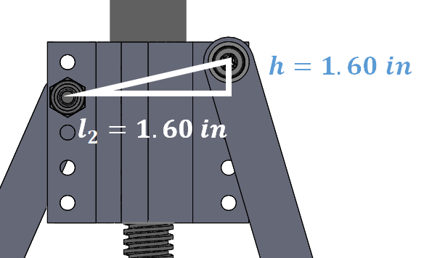
ANALYSIS & PRELIMINARY TESTS
Change angle of pivot points by changing h to change pitch and roll and create an asymmetrical linkage
Measure the distance between linkage connections and the height difference between linkage connections

Slide 6
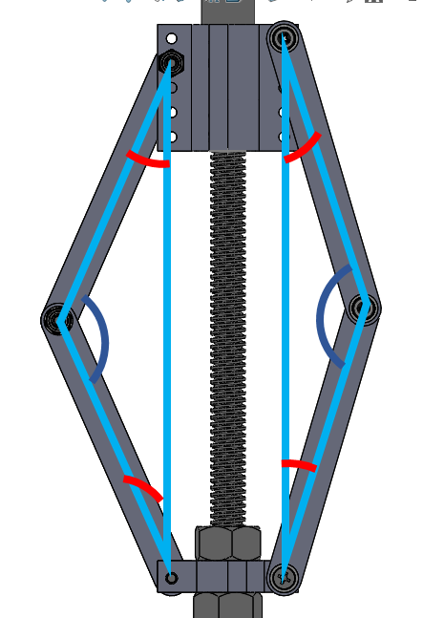
l=4 in
l
B1
B2
B2
B1
lcos(B1)
lcos(B2)
A2
A1
lsin(B1)
lsin(B2)
y-h
y
B2
B1
h/2
l*[sin(B1)+sin(B2)]+1.60

Slide 7
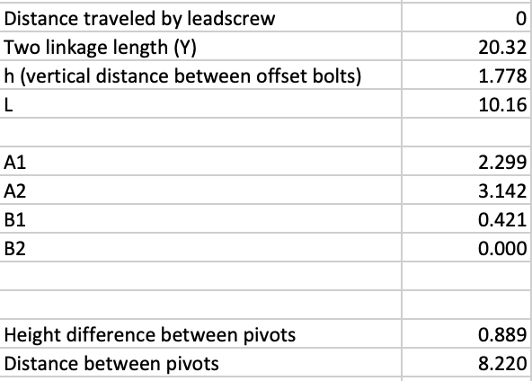
Pivot analysis
L = 4in
L = 4in
A1
B1
B1
cos(A1) = ((2*l^2-(y-h).^2)/(2*l^2))
cos(A2) = ((2*l^2-y.^2)/(2*l^2))
cos(B1) = (y-h)/(2*l);
cos(B2) = (y)/(2*l);
Apply law of Sines
sin(B1) = sin(A1)*l/(y-h);
sin(B2) = sin(A2)*l/(y)
y-h
Height difference between pivots
= l*[cos(B2)- cos(B1)] = 0.5*h
Found that the relative height of pivots should be 0.5*h because linkages are the same height
Distance between pivots = l*[sin(B1)+sin(B2)]+1.60

Slide 8
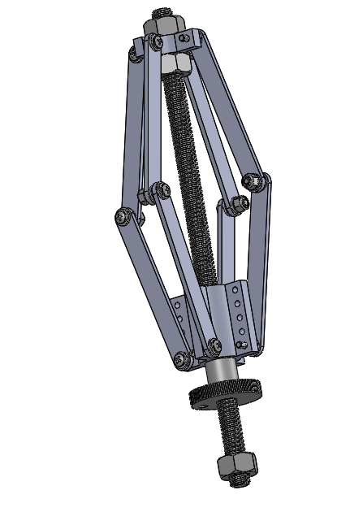
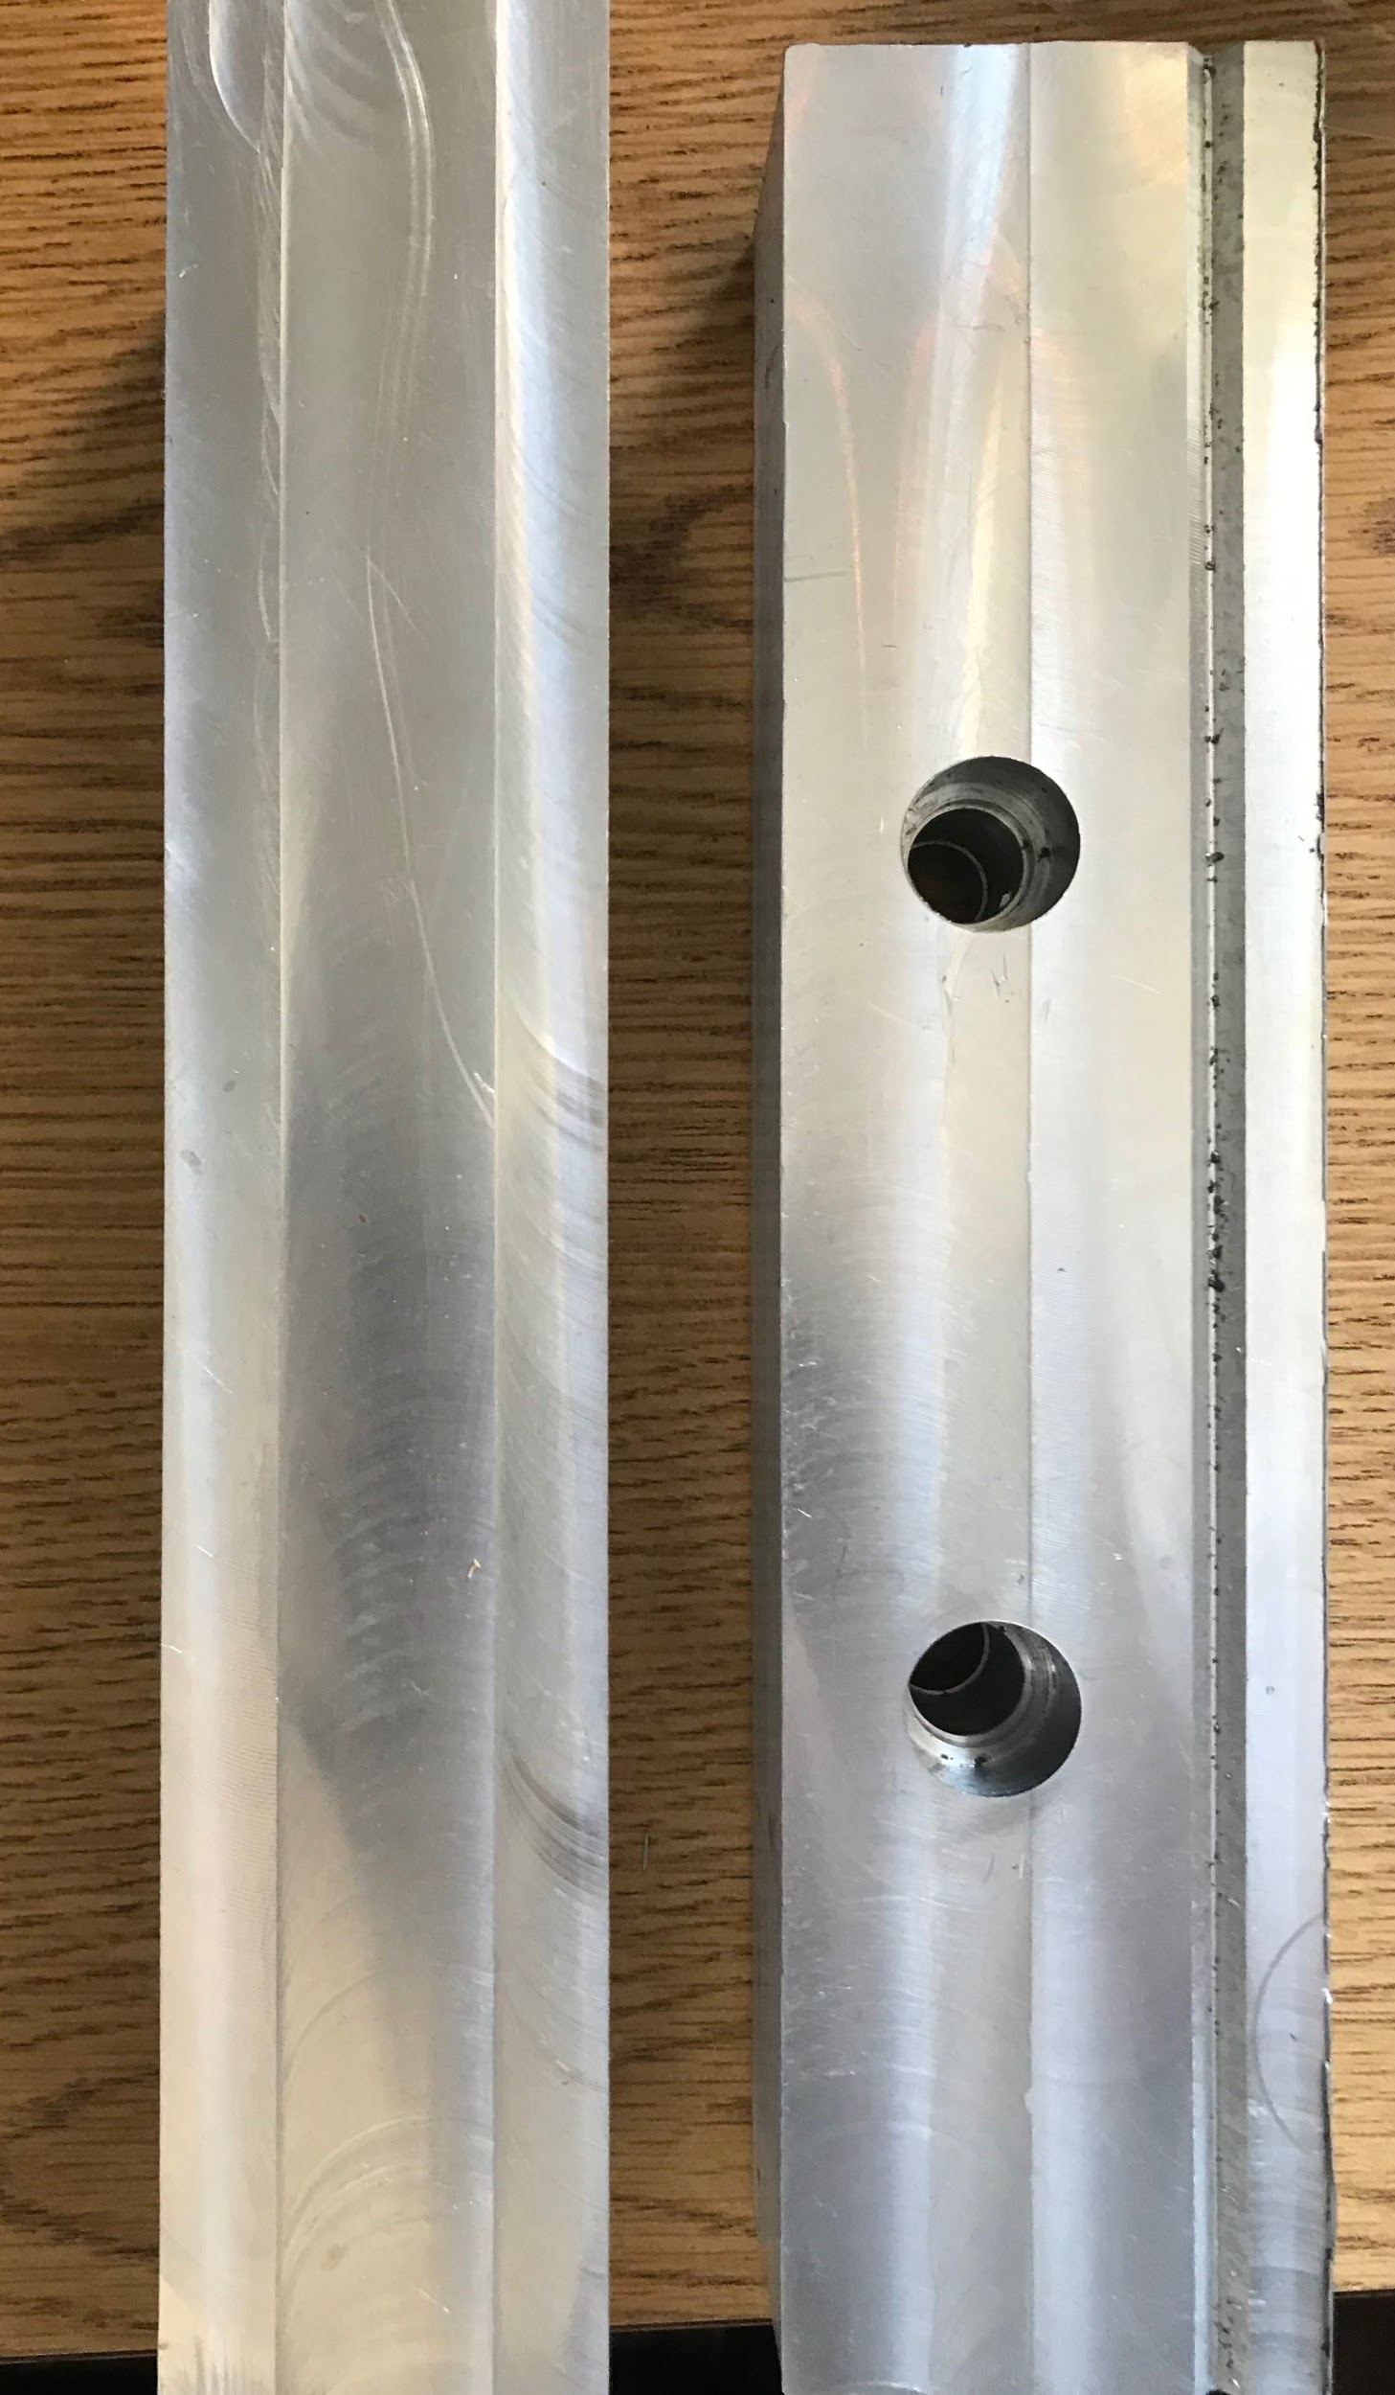
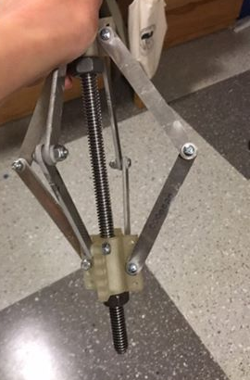
Assembly
Jaws for machining key in lead screw

Slide 9
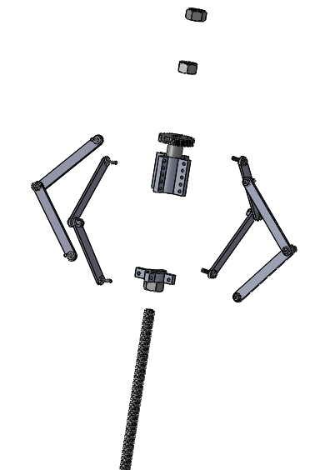
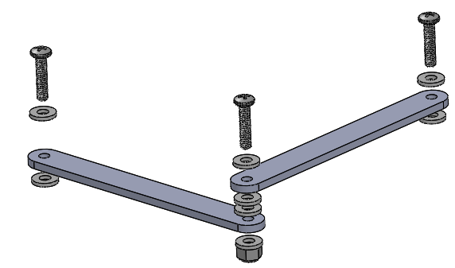
Bill of Materials
 | Part | Quantity
1 | Linkages | 8
2 | 8 - 32 Round Head Bolts | 36
3 | 8-32 Lock Nuts | 36
3 | 8 - 32 Nylon Washers | 36
5 | 12 ‘’ long lead screw with 1/2"-10 threads | 1
6 | Carriage | 1
7 | Base Carriage | 1
8 | 1/2"-10 Flange Nut | 1
9 | 1/2"-10Carbon Steel Acme Hex Nut | 3

Slide 10
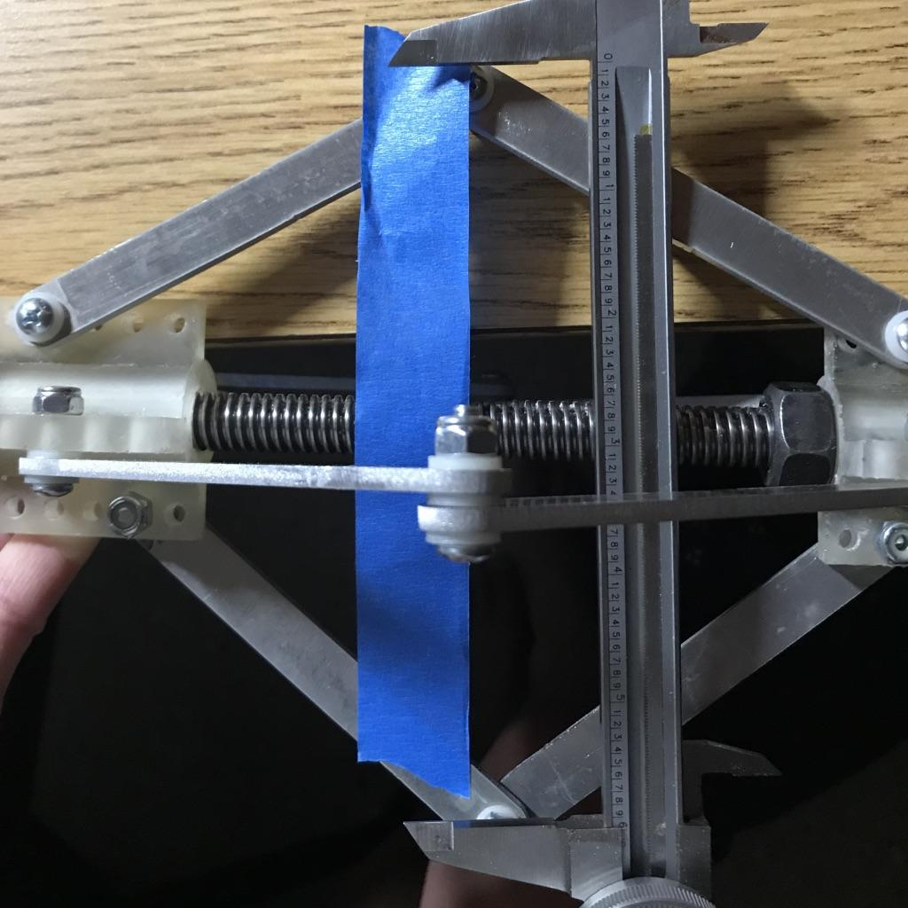
Test Setup
Measure vertical difference in pivot height
Measure horizontal distance between pivot points

Slide 11
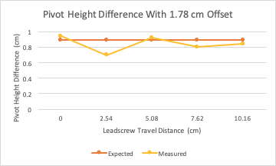
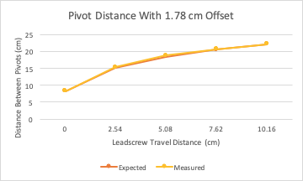
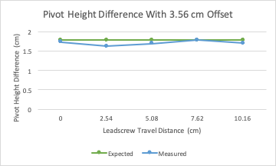
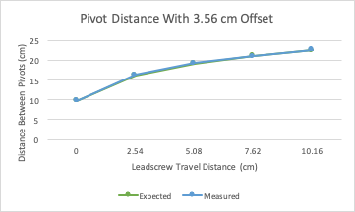
Results

Slide 12
Design Lessons
The measured Abbe error matches the predictions, and Abbe error increases with increased initial offset. Measured values tend to be slightly lower than expected, which is likely due to Abbe error into the plane, clearance, or measurement error.
Abbe error into the plane Error caused by linkage connections that are not perfectly linear (slop)
Clearance error Lead screw key has small radial clearance that could cause error
Further Improvements
-Create a handle to aid in rotation of the flange nut
-Create fixture to secure device for more accurate measurement
-Lead screw took a lot of time to machine, consider outsourcing the manufacturing of the keyhole slot in lead screw or redesign the carriage

Slide 13
Time Budget
Category | Serena (hrs) | Tahina (hrs)
Design | 4 | 5
Analysis | 1 | 2
Manufacturing of Jaws for Lead Screw keyhole | 5 | 7
Assembly of final version | 8 | 0
Testing | 1 | 0
CAD + Documentation | 1 | 3
Total | 20 | 17

